Slide 1
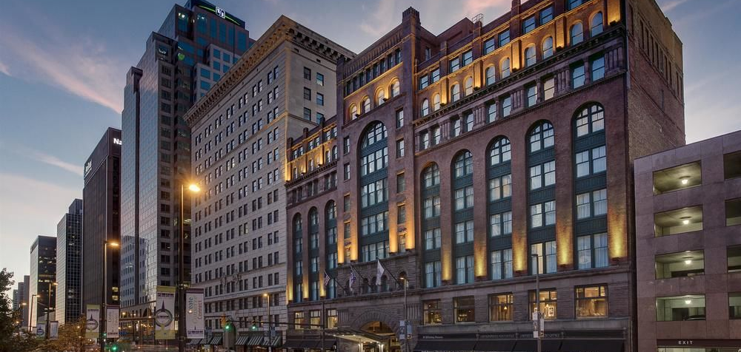
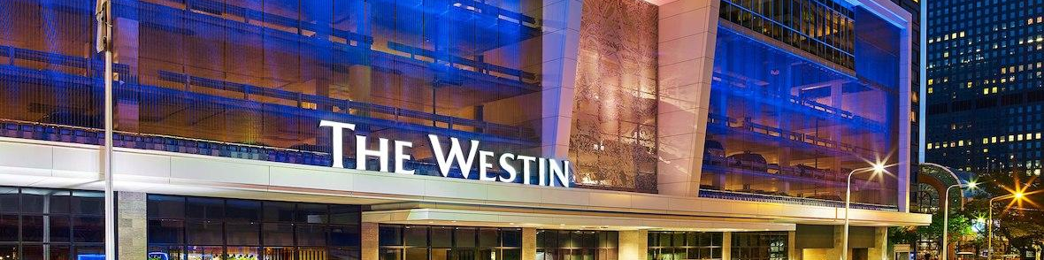
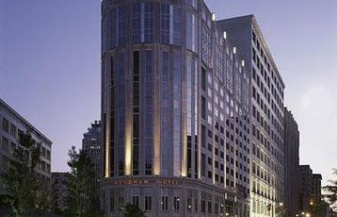
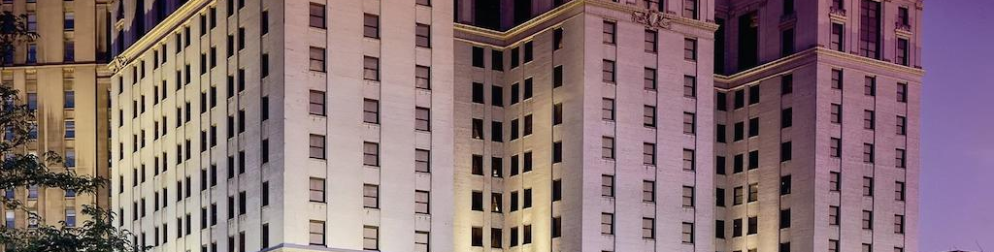
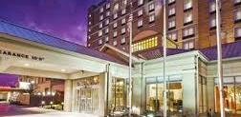
BEST HOTELS - CLE
Lydia Stump - Xiaohan Li - Rob Rua - Gaston Alvarado

Slide 2
Agenda
Motivation & Summary Slide
Questions & Data
Data Cleanup & Exploration
Data Analysis
Discussion
Post Mortem
Q&A

Slide 3
Motivation & Summary Slide
Core Message
Questions Asked
Questions Not Answered
We can use code to determine the elements of a good hotel experience in Downtown Cleveland.
What makes a good Hotel in Downtown Cleveland?
Do national brands have more and/or higher ratings?
What words with positive polarity occur most often?
Do they indicate what customers value the most?
How does location affect ratings?
How does price level affect ratings?
How does seasonality affect ratings?
How do responses to reviews affect ratings?
What elements affects the ratings the most?

Slide 4
Questions & Data
Data Sources
The initial questions were related to find out how the rating is related to a a good Guest experience
Based on that assumption, we wanted to determine what are the elements that influence the most the ratings given by Guest to Hotels, including factors like weather, seasonality, location, etc
It was also discussed as an important factor if national brands have reputation influence in the Guests while assigning ratings
Google Place API
nearby search
place details
Elements we pulled:
Rating
Review
text
time
Address
Geometry
Name
Total ratings

Slide 5
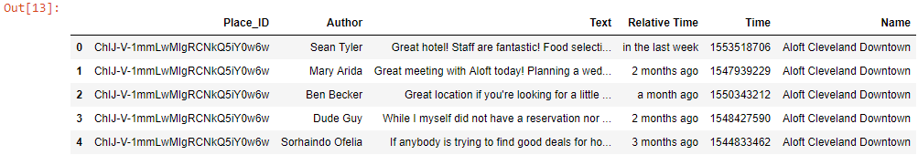
Data Clean-Up and Exploration
Call APIs for nearby and detail search in Google
Build data frames and clean the data
Merge the two frames
The dataset contains the reviews, which is the key for all the analysis, and all other relevant data by property.

Slide 6
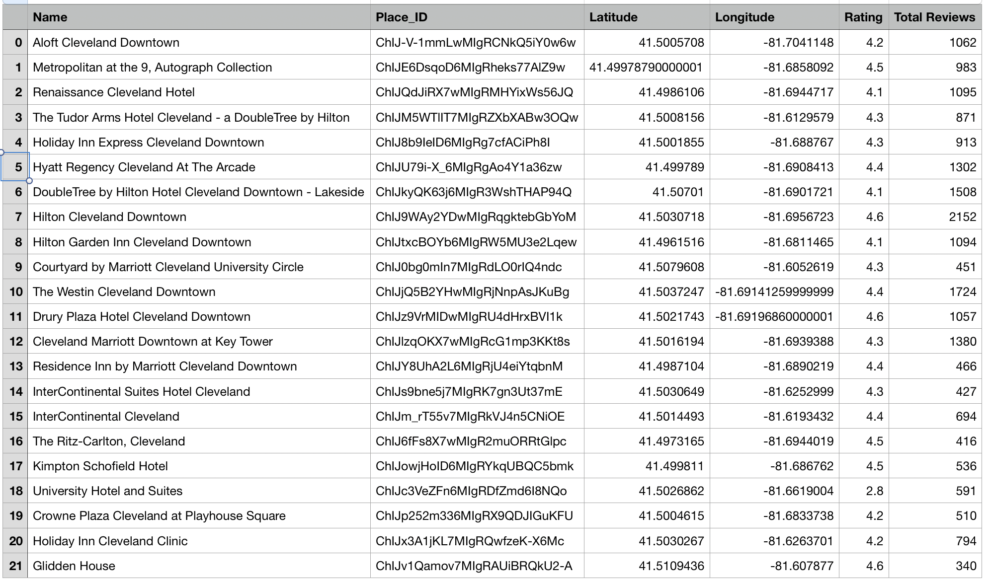
Data Clean-Up and Exploration
Data as of March 28, 2019.
Different results with each Google maps api call (nearbysearch - type: lodging)
Google limits the number of results that can be called to 20 per api call (free acct.) - but allows 3 calls
3 calls resulted in 41 returns
Results returned non-hotels (parking lot, spa, alt spellings)
Removed non-hotels using dictionary, resulting in 22 hotels within specified radius
Google Places api call to obtain hotel reviews
Google limits to 5 reviews per location

Slide 7
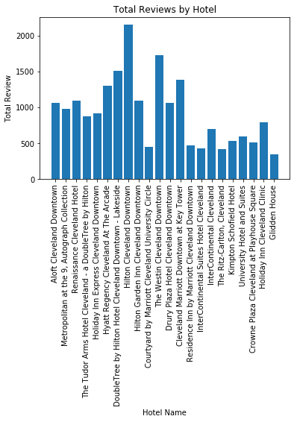
Data Analysis - Brands
National chains receive significantly more reviews overall and offer more incentives for business travelers. They also have access to top-down corporate incentives and access to popular booking websites.

Slide 8
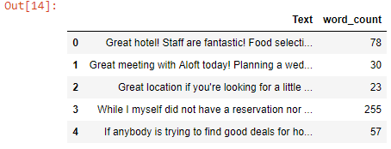
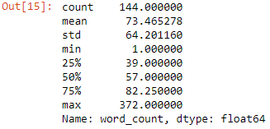
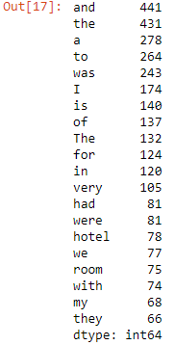
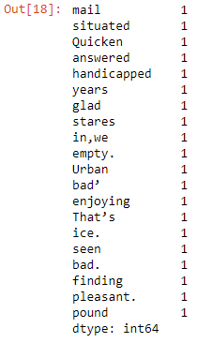
Data Analysis – Word Count
Word count and running basic statistics as an initial exploration of the dataset allowed us to better understand the size of the dataset as well as the variation in word counts across the rows.
The average word count is about 73 words per review. The word count ranges from a minimum of 1 to a maximum of 372.
Most Frequent Words
Less Frequent Words
Initial analysis of the most frequent and less frequent words helped to visualize all the words that are subject to be removed and added to the stopwords

Slide 9
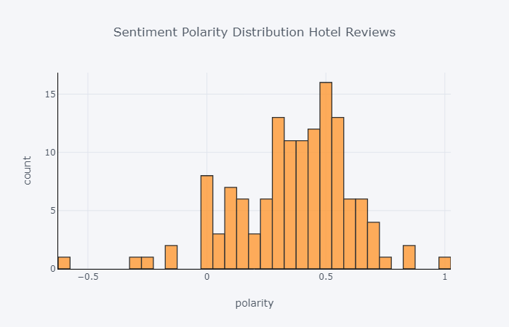
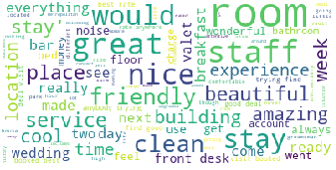
Word Analysis
Sentiment Polarity Histogram
A great majority of the reviews tend to be positive comments, which is can be confirmed with the high ratings found in the brand review
Clean-Up Process
Sentiment Polarity
5 random reviews with the highest positive sentiment polarity:
Besides this being a gorgeous hotel, they were one of the friendliest staffs I have ever met. The food was also very tasty, the bed extremely comfortable and location amazing. Cannot wait to go back again and hopefully soon!
Very nice hotel with a friendly staff.
-1=Negative
1=Positive
1
Normalization
Handling multiple occurrences / representations of the same word
-Stemming - Normalizes text by removing suffixes
-Lemmatization -Technique that works based on the root of the word
5 reviews with the most negative polarity:
I gave this place a one so I could write this message. The room was dark and you had to lift up on the door to get it to shut. There is no elevator. The bathtub was nasty with 0 supplies. We had to call the front desk 2 separate times to have them come to our floor and ask the screaming woman to settle down.
Word Cloud
After clean-up process, a snapshot using a word cloud provides a visual of the most frequent words based on the word count
2
Noise Removal
- Removing redundant text components
-Punctuation, tags, stop-words

Slide 10
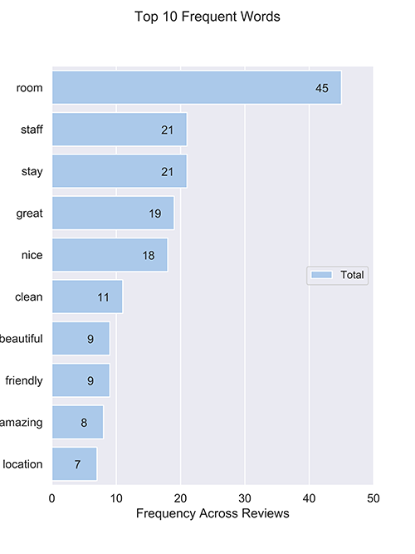
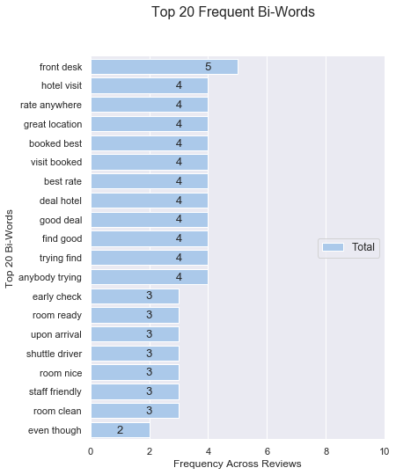
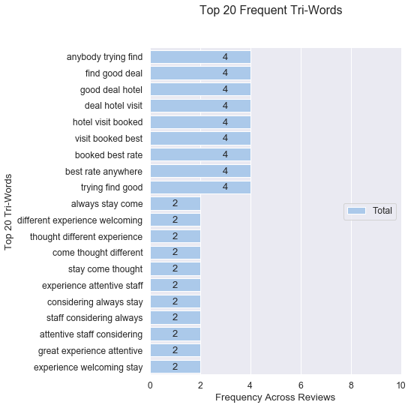
Data Analysis - Top Uni-grams, Bi-grams & Tri-grams
The association of the uni, bi, and tri-grams shows a consistent relation between all the values that are related or directly derived from Staff interactions or activities. This is consistent with the word cloud.
Staff-related positive reviews

Slide 11


Data Analysis – Analysis TF-IDF
Words With The Highest Score
Since the large counts of certain common words may dilute the impact of more context specific words in our dataset, We used the TF-IDF vectorizer analysis, which penalizes words that appear several times across the document.
TF-IDF are word frequency scores that highlight words that are more important to the context rather than those that appear frequently across documents, and it is calculated as follows:
 | Score
clean comfortable desk | 0.173
comfortable desk | 0.173
comfortable desk bit | 0.173
desk bit | 0.173
desk bit bathroom | 0.173
fancy | 0.173
functional | 0.173
functional fancy | 0.173
good room | 0.173
good room clean | 0.173
helpful restaurant | 0.173
helpful restaurant quite | 0.173
polite helpful | 0.173
polite helpful restaurant | 0.173
quite good | 0.173
quite good room | 0.173
restaurant quite | 0.173
restaurant quite good | 0.173
team polite | 0.173
team polite helpful | 0.173
TF — term frequency
IDF — Inverse document frequency

Slide 12
Discussion
Even though we were not able to take the analysis to the level of detail we wanted due to the limitations in the data (i.e. limited dataset, access to price level)
We utilized the data we received and were able perform an extensive analysis and at the end infer that there is a relation between a good guest experience with the activities and interactions they have with the Hotel’s Staff - i.e. customer service is a differentiator

Slide 13

Post Mortem
APIs for major booking sites are limited to hotels and travel agencies
Google Place API has limitations on what and how much data you can call using the free version.
Only 60 responses total (3 calls, 20 each), which affected our geographic bounds
Reviews returned are limited to 5 per property, which limited our ability to do a robust analysis of the reviews
Timestamp vs. Datetime did not allow us to estimate the time when reviews were created
Returned information does not include details of the Hotels’ response to the Guests, which limited our ability to evaluate if the number of responses influenced the ratings

Slide 14
Q&A

Slide 15
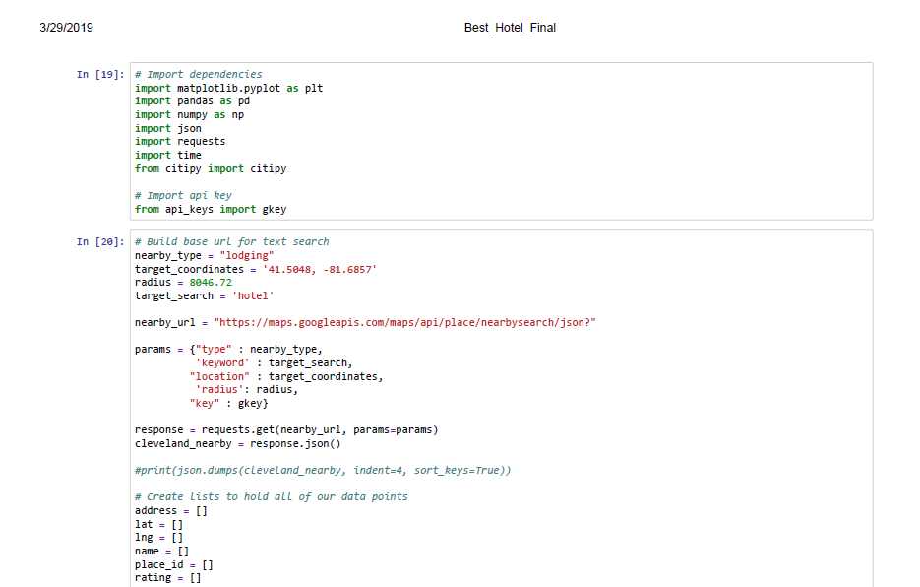
Appendix

Slide 16
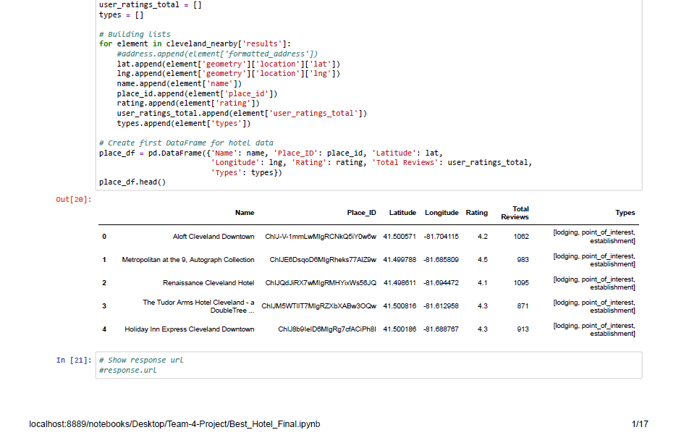
Appendix

Slide 17
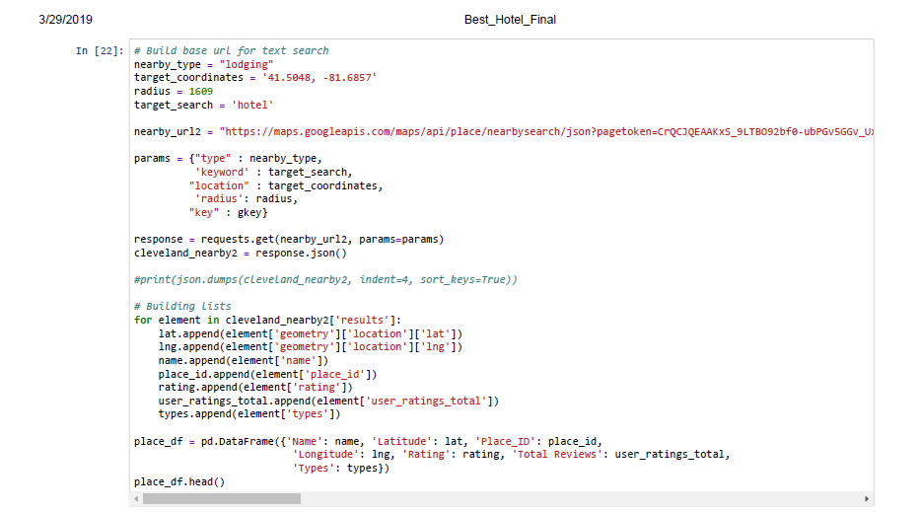
Appendix

Slide 18
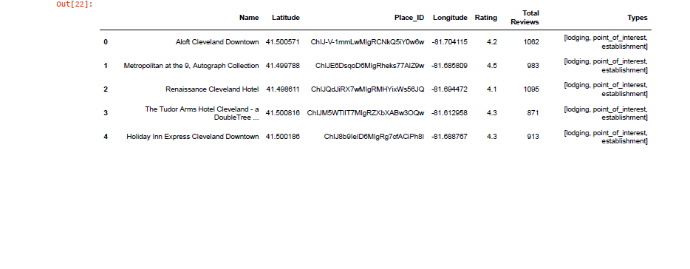
Appendix

Slide 19
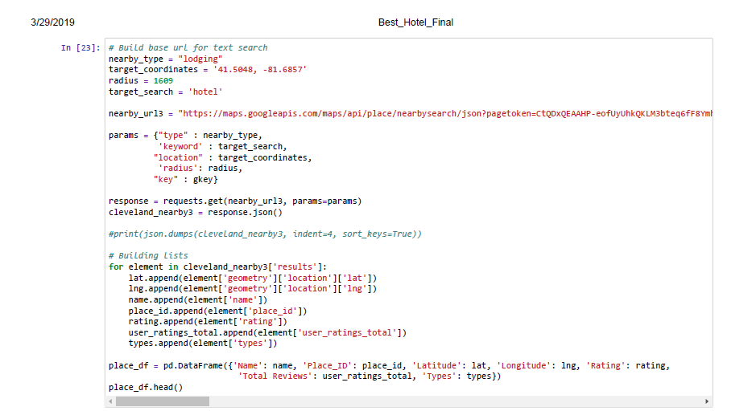
Appendix

Slide 20
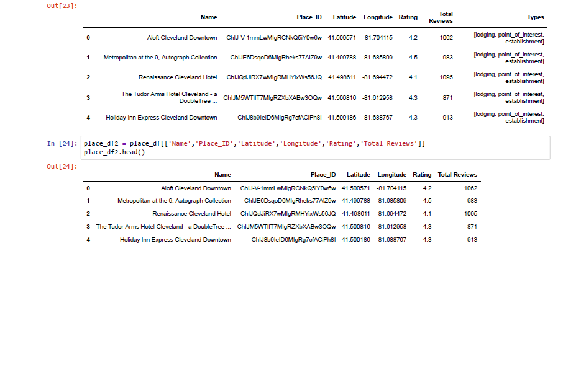
Appendix

Slide 21
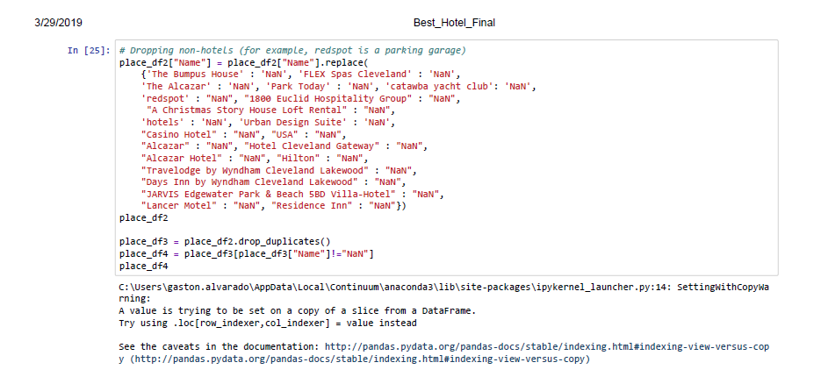
Appendix

Slide 22
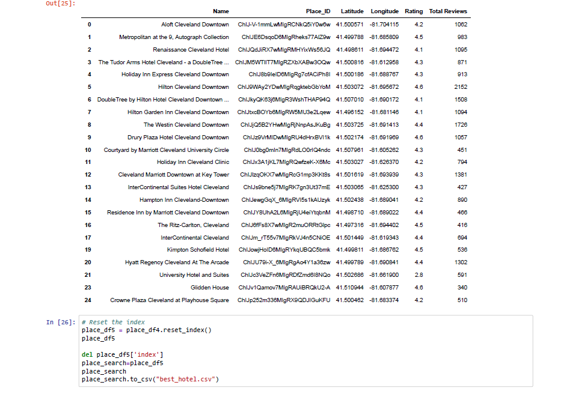
Appendix

Slide 23
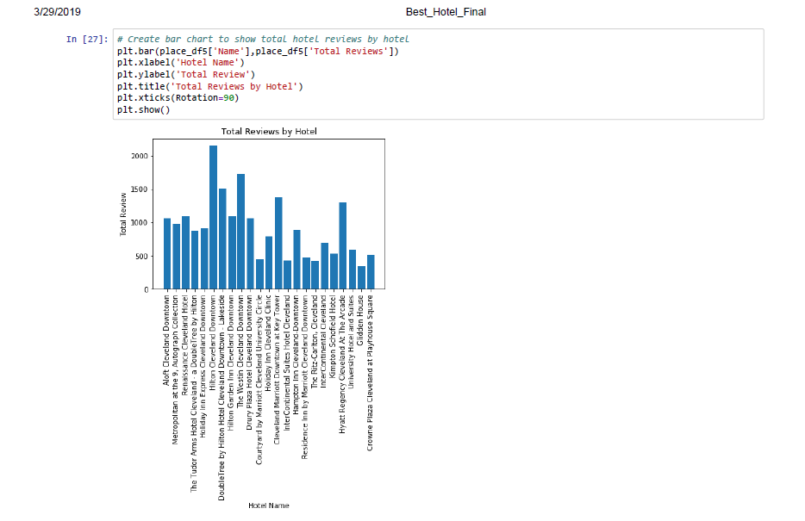
Appendix

Slide 24
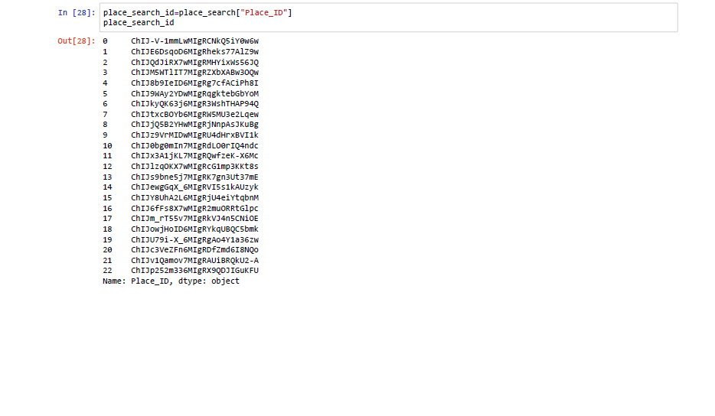
Appendix

Slide 25
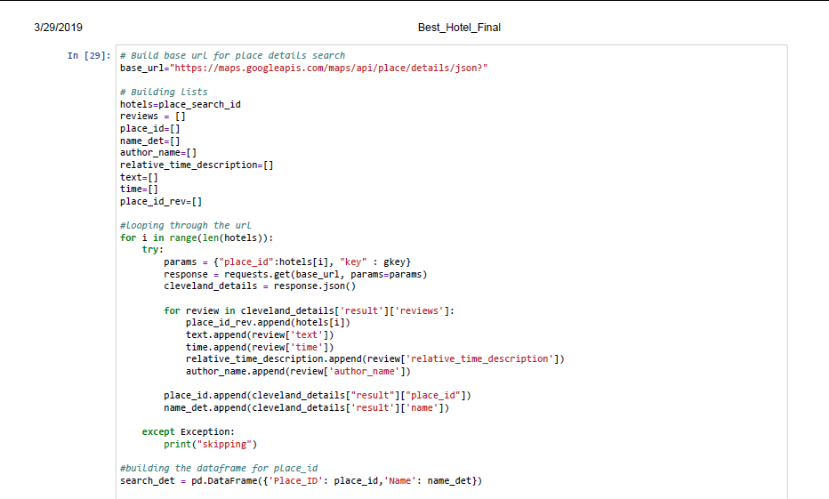
Appendix

Slide 26
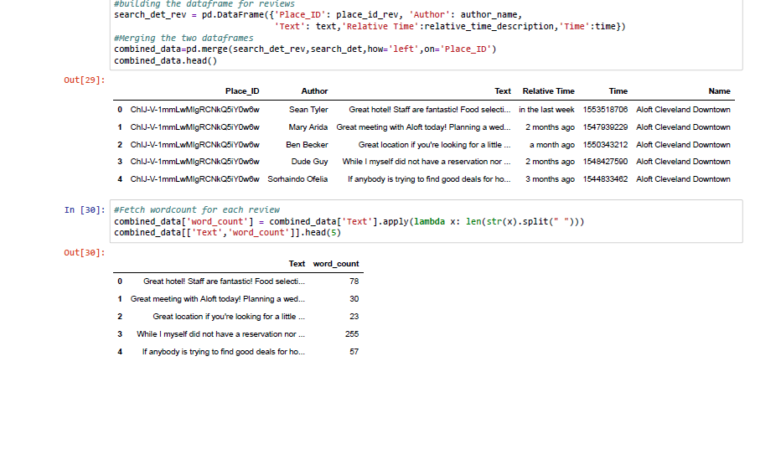
Appendix

Slide 27
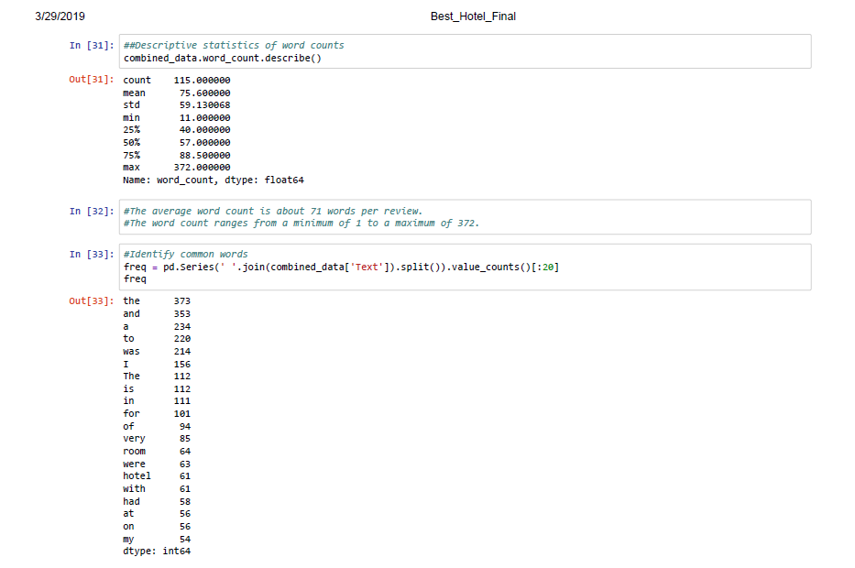
Appendix

Slide 28
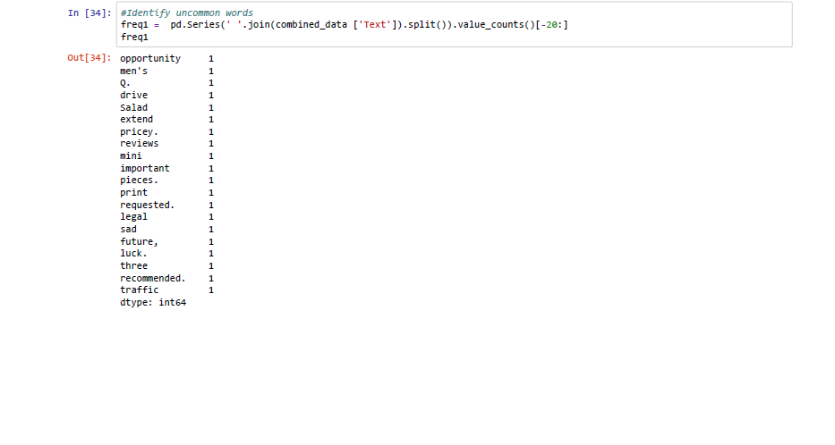
Appendix

Slide 29
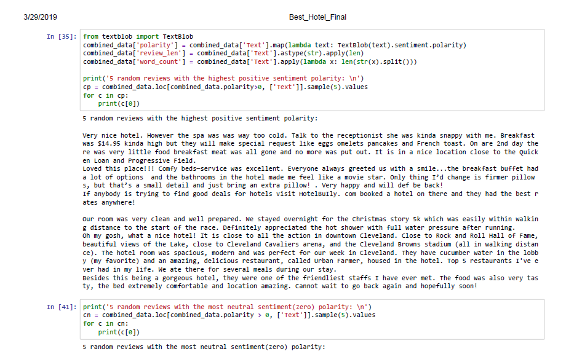
Appendix

Slide 30
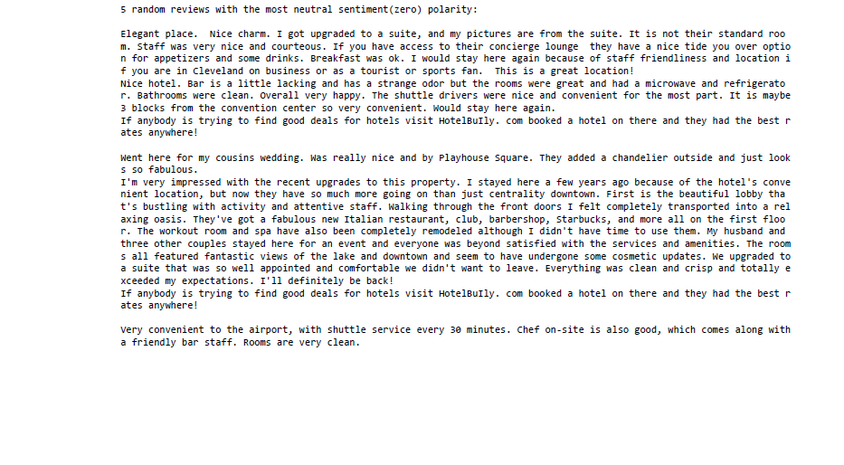
Appendix

Slide 31
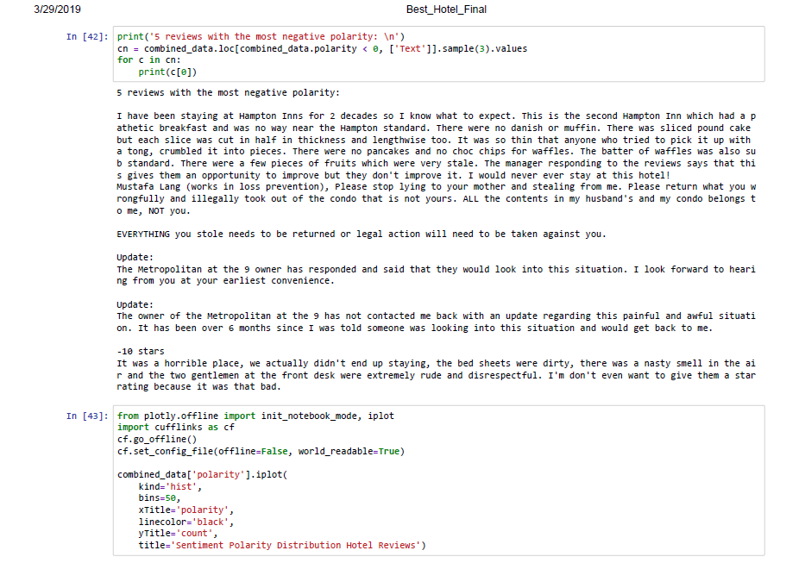
Appendix

Slide 32
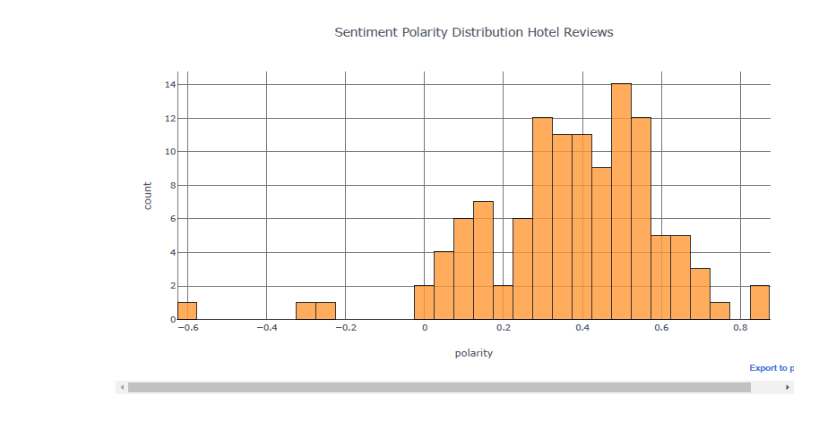
Appendix

Slide 33
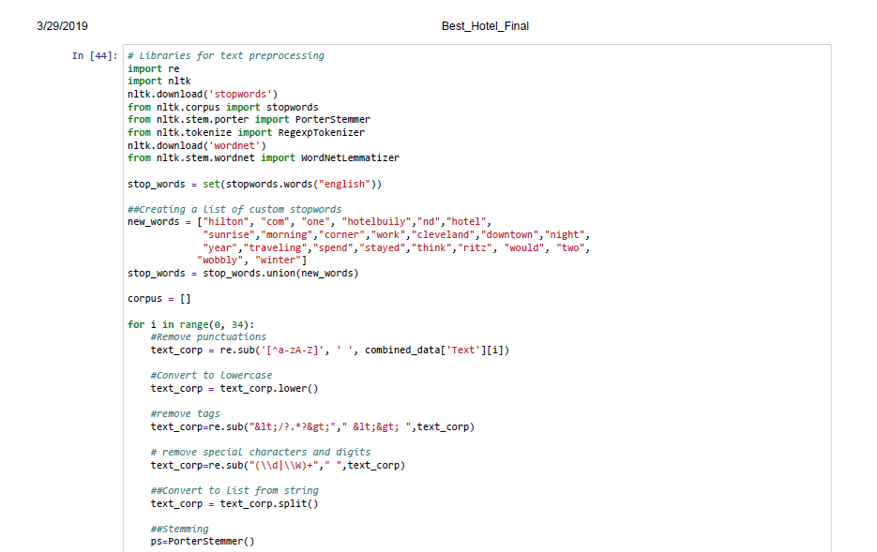
Appendix

Slide 34
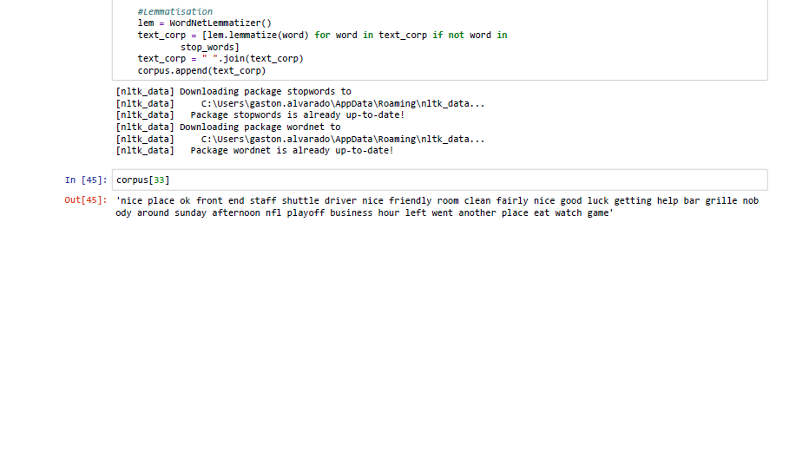
Appendix

Slide 35
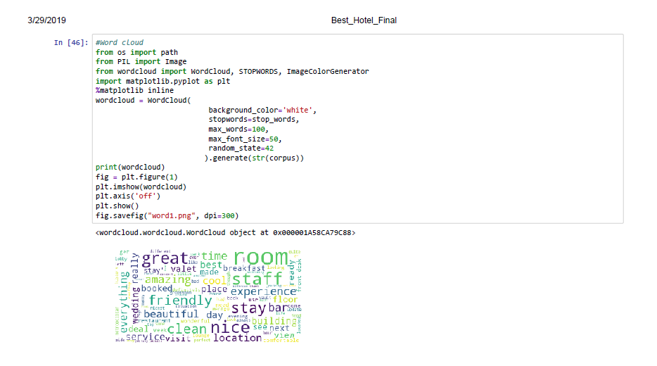
Appendix

Slide 36
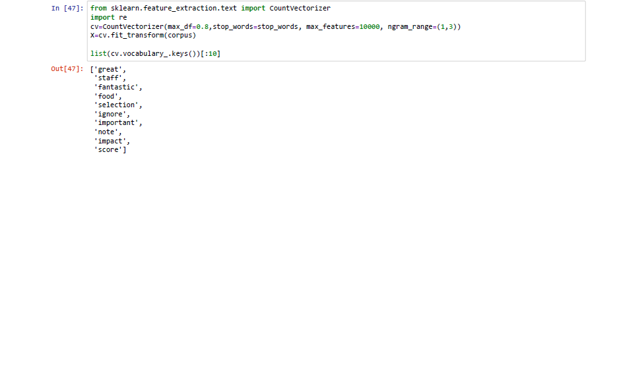
Appendix

Slide 37
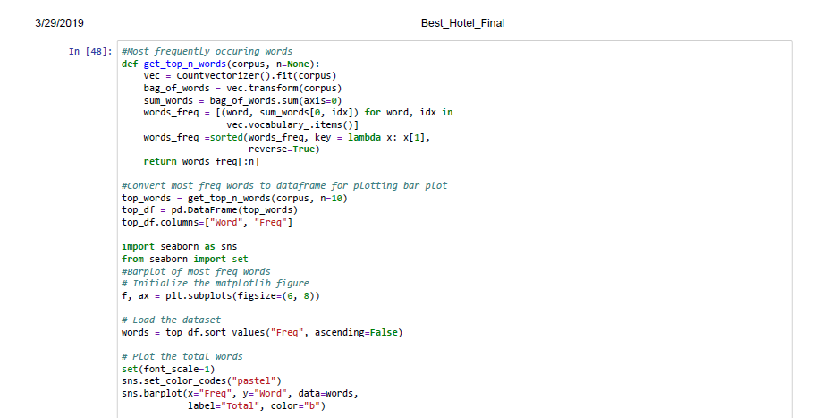
Appendix

Slide 38
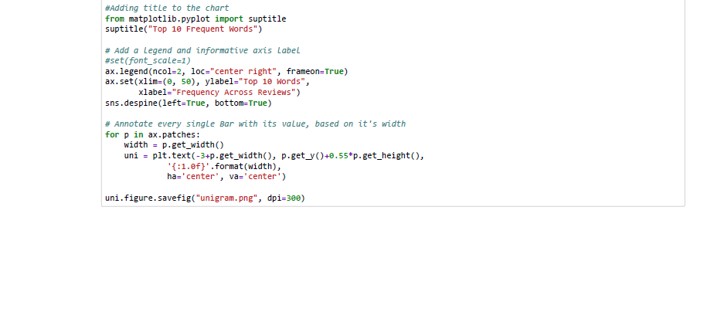
Appendix

Slide 39
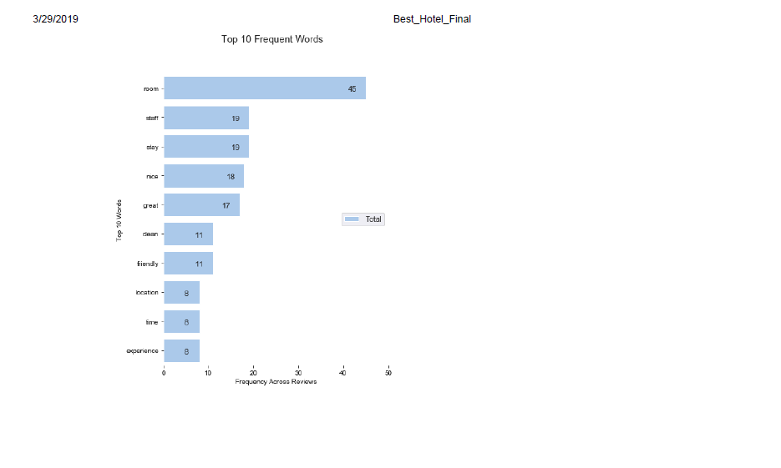
Appendix

Slide 40
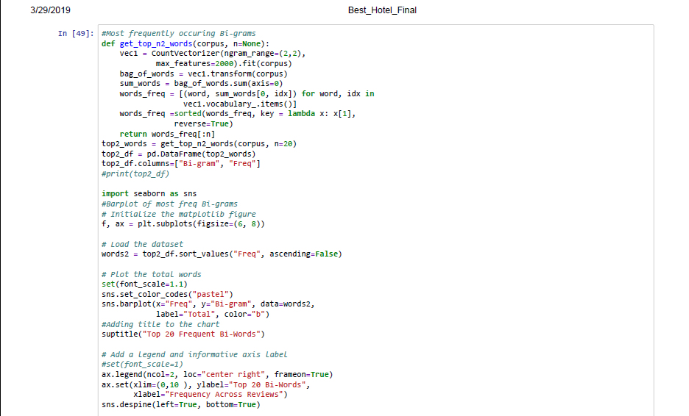
Appendix

Slide 41
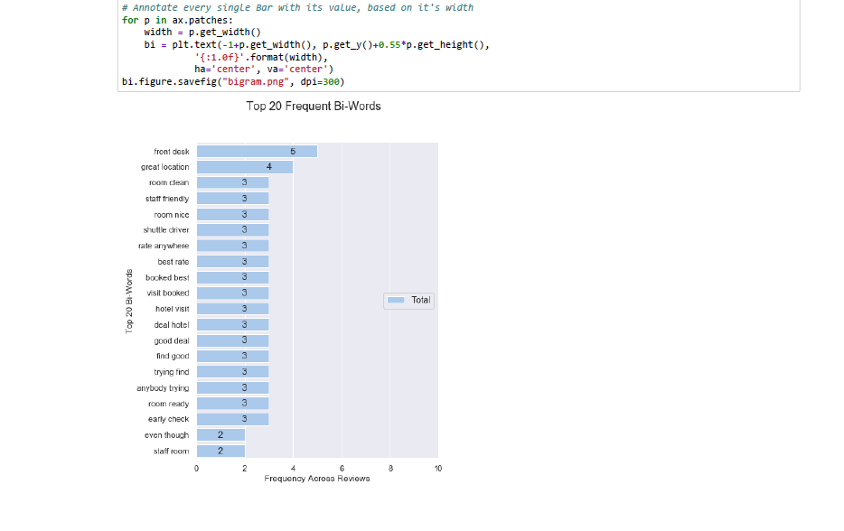
Appendix

Slide 42
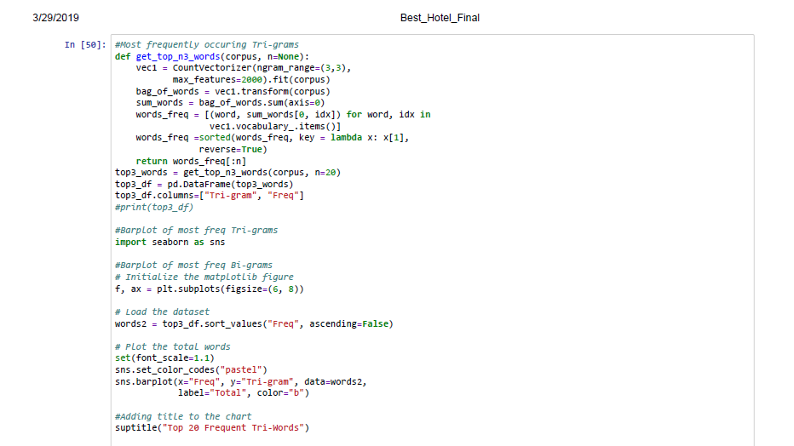
Appendix

Slide 43
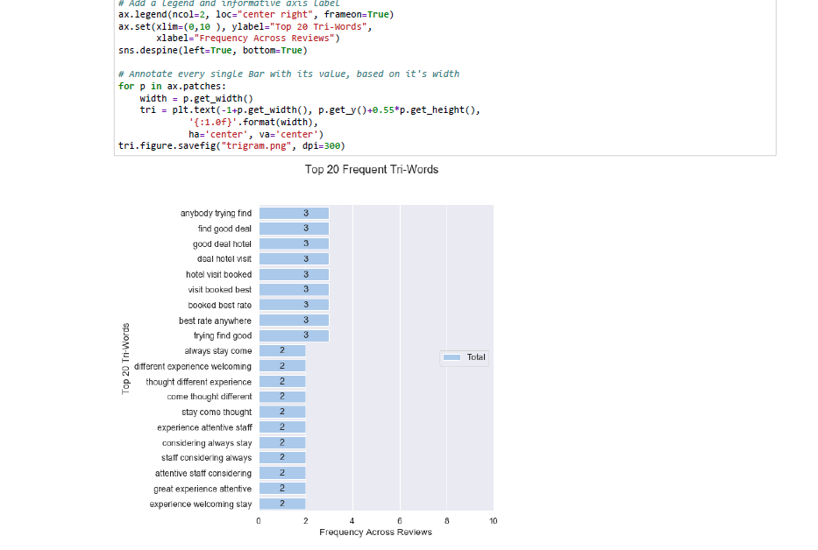
Appendix

Slide 44
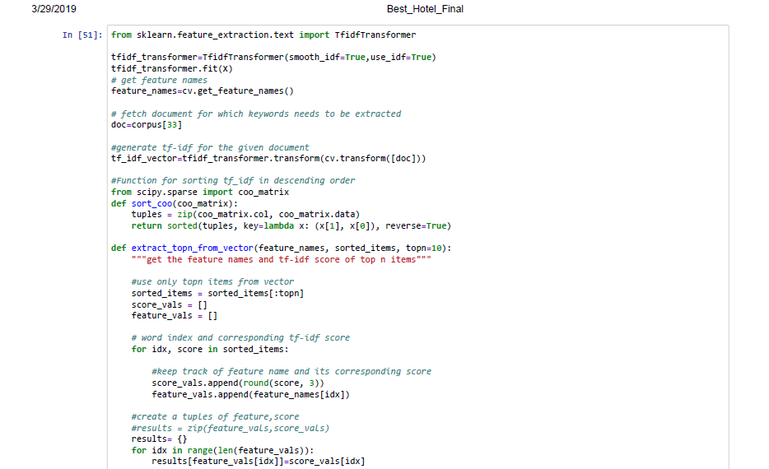
Appendix

Slide 45
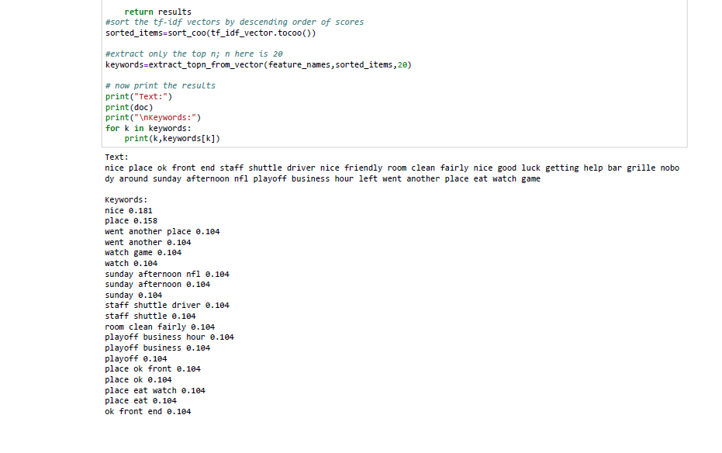
Appendix

Slide 46
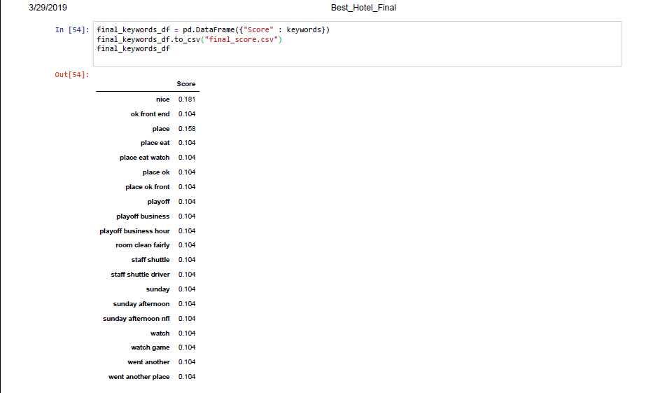
Appendix

